Slide 1
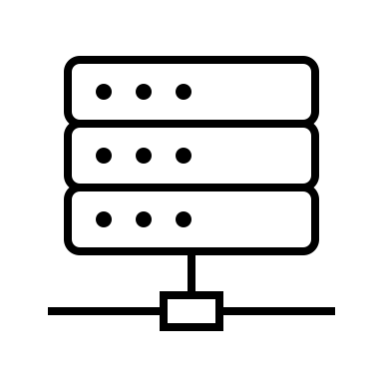




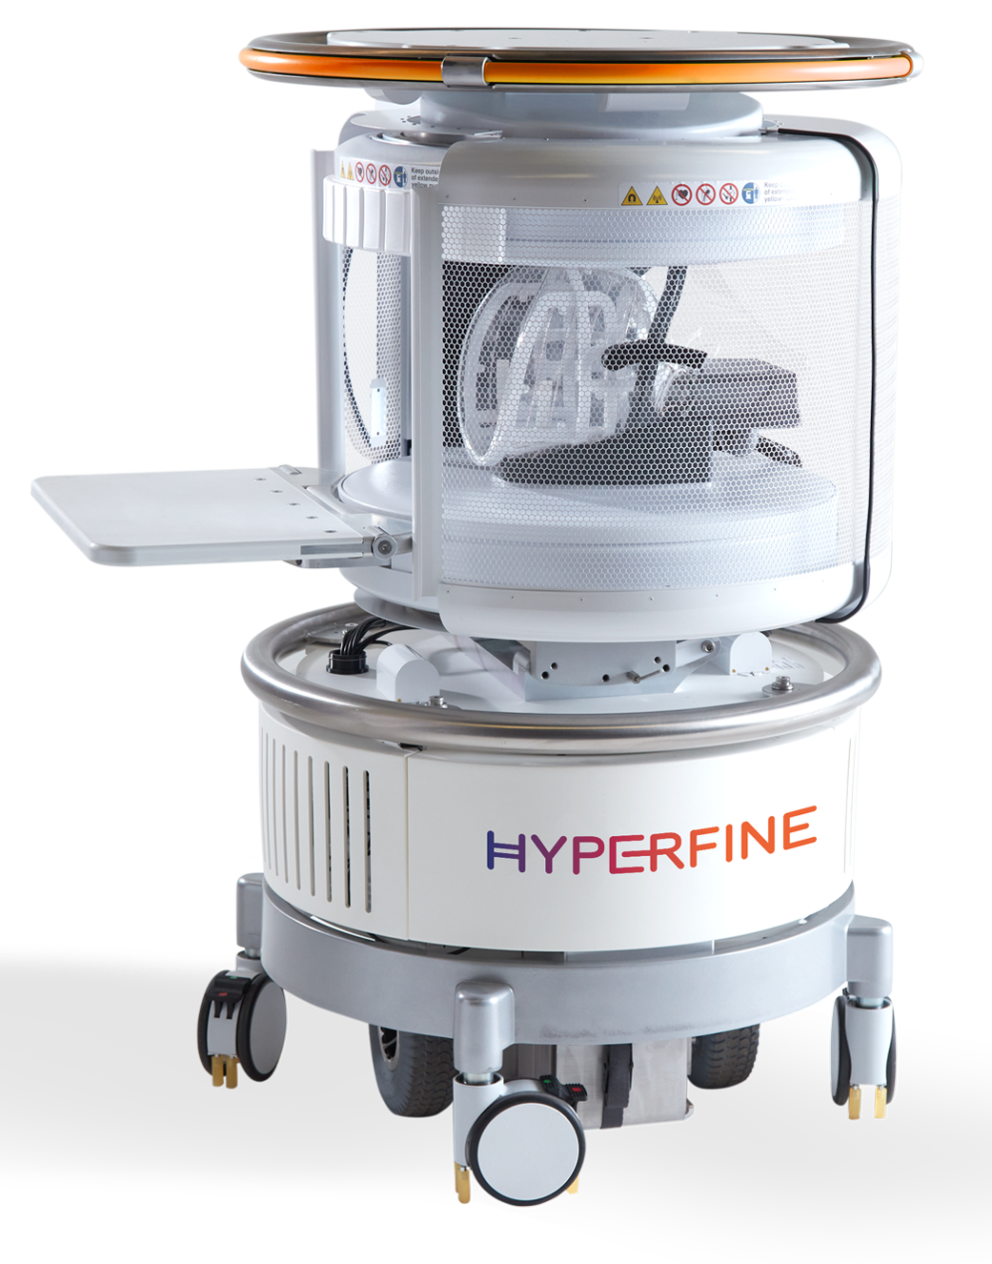





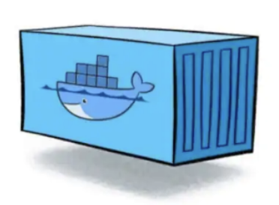
Building analysis containers → processing ← uploading data
Sagittal T2-Weighted
Gear Development
Host
Research site
Flywheel
Base images
OS
app
Engine
CISO
Web interface
SynthSeg
Containers
Storage

Slide 2
Locally optimising analysis to implement in the wider cohort
Sagittal T2-Weighted
Optimisation
Gear Development
Host
Low-field Image reconstruction
IQT
Tissue segmentation in neonates
DTI?
…
Flywheel
Base images
OS
app
Engine
CISO
Web interface
SynthSeg
Containers
Storage

Slide 3
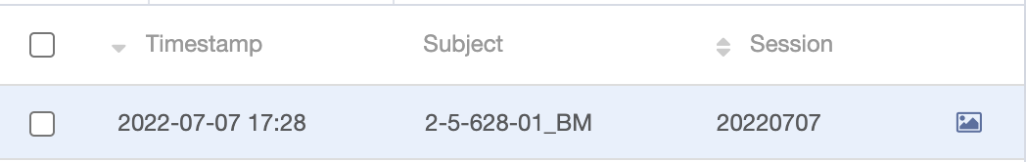
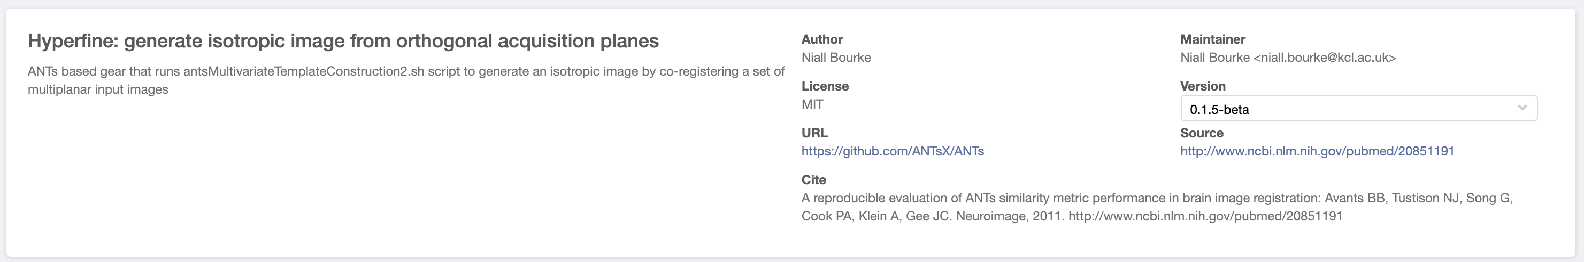
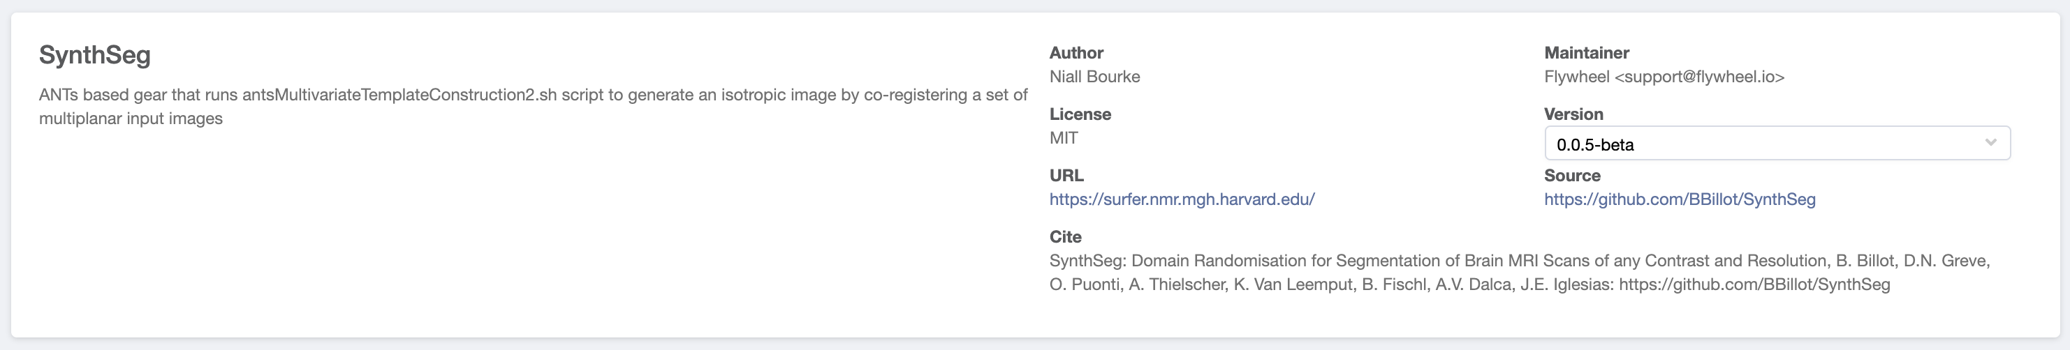
Flywheel workflow
User upload
Utility gears
Manual checks
User initiated (currently)
Data uploaded
File Classifier
DICOM to NIFTI
BIDS curation
QC labels
Analysis
Automatically run
Newly developed gears (beta)
*Tested with 3yo
- Good reconstructions
- Good segmentations
- Good parcellations
- ROIs appear overestimated, possibly due to adult priors
Need to batch upload 3mo Khula and test workflow
This tool implements SynthSeg, the first convolutional neural network for segmentation of brain MRI scans of any contrast and resolution that works out-of-the-box, without retraining or fine-tuning. SynthSeg relies on a single model, which we distribute here. This model is robust to:
a wide array of subject populations: from young and healthy to ageing and diseased subjects with strong atrophy,
white matter lesions (see green arrows in image below),
scans with or without preprocessing (bias field corruption, skull stripping, intensity normalisation, registration to template).
The output segmentations are returned at high resolution (1mm isotropic), regardless of the resolution of the input scans. The code can run on the GPU (6s per scan) as well as the CPU (2 minutes per scan). The list of segmented structures can be found at the bottom of this page.

Slide 4
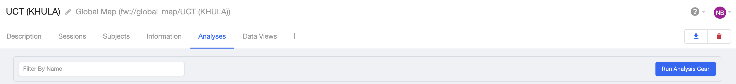
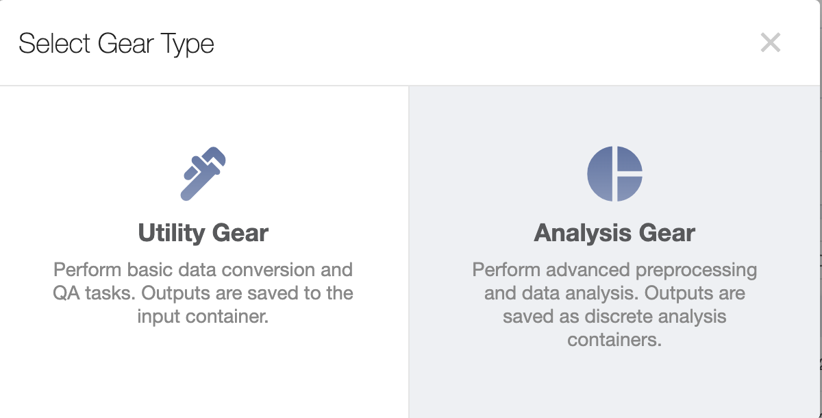
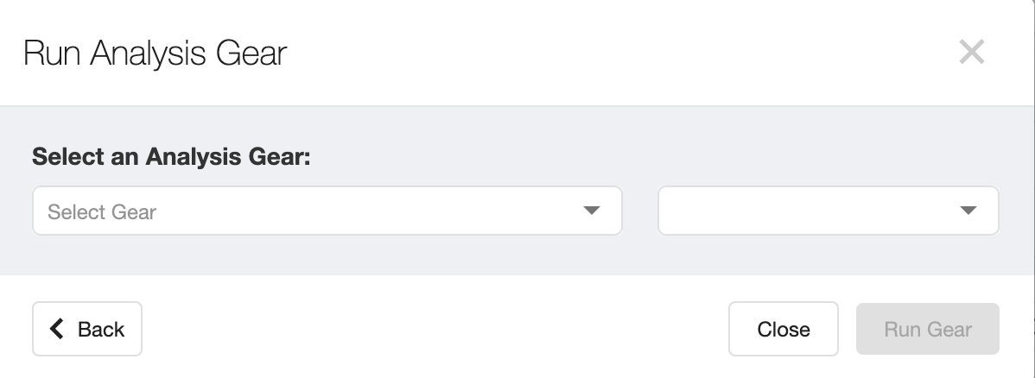
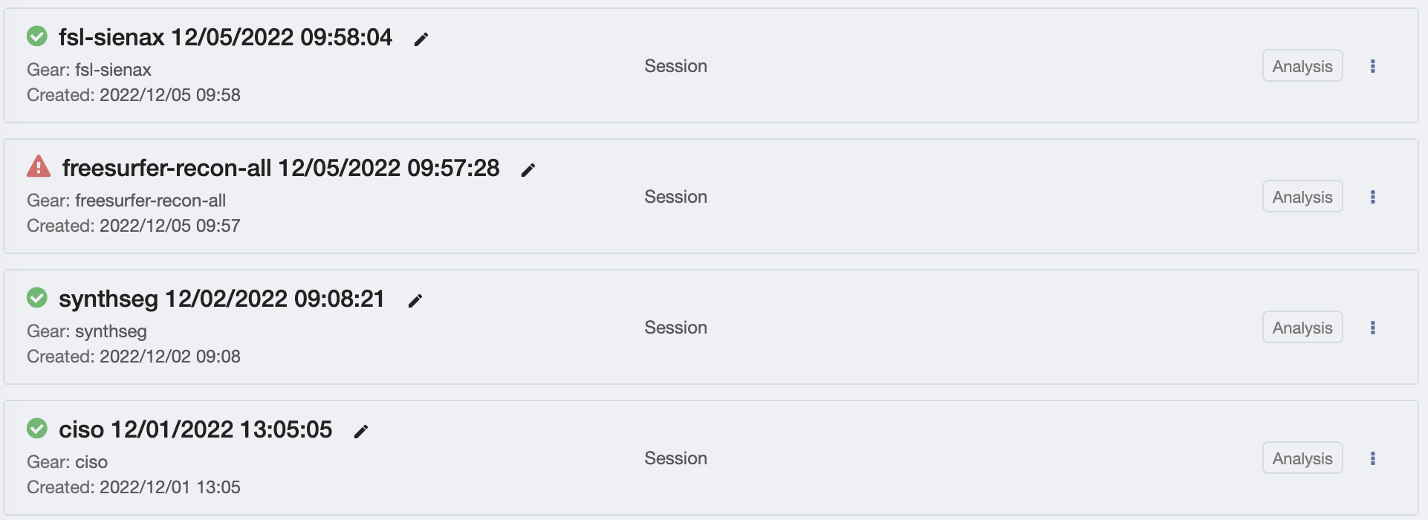
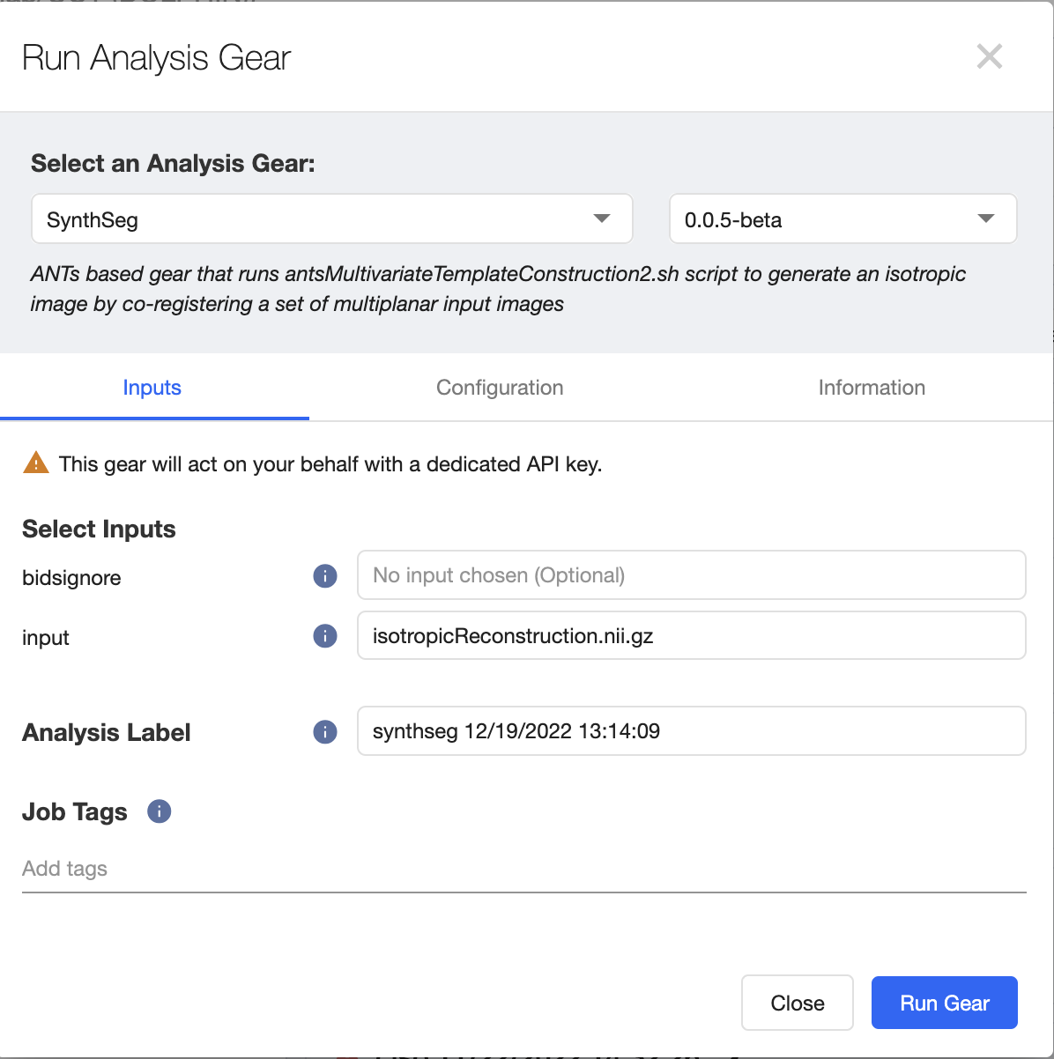
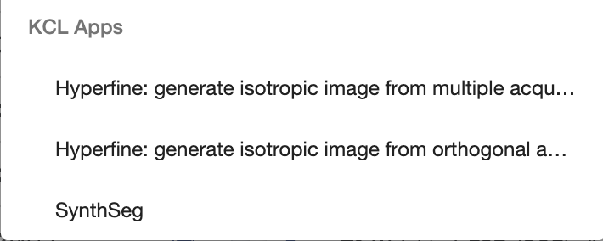
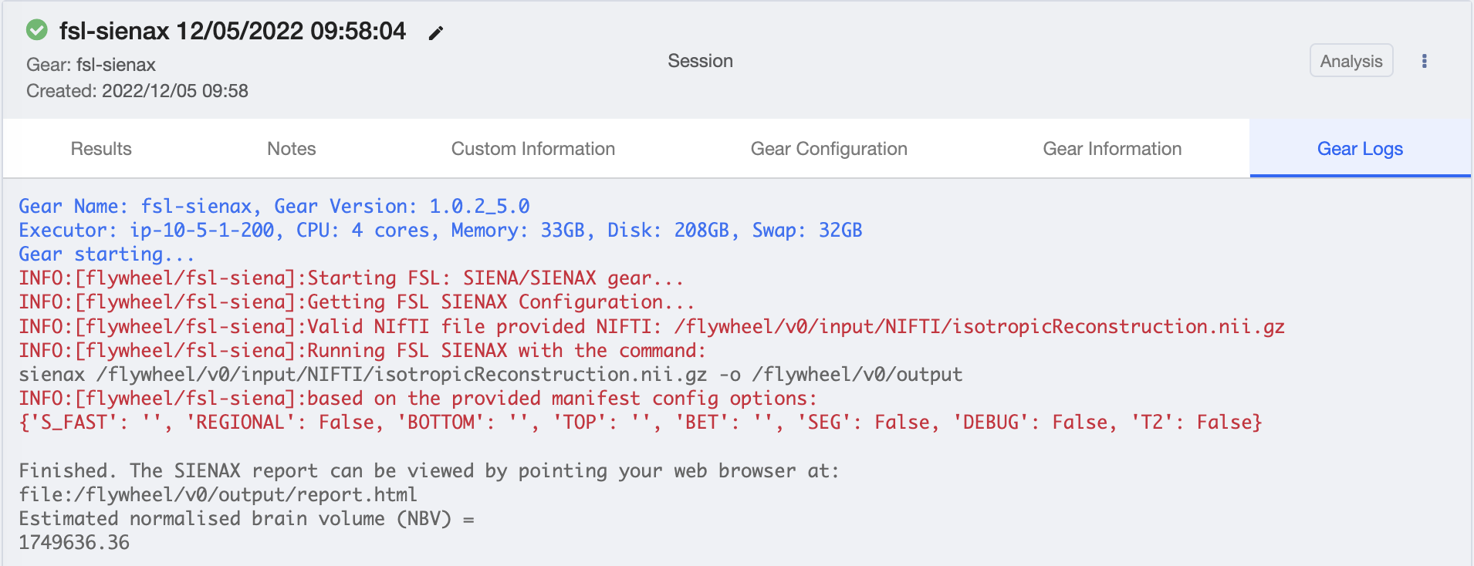
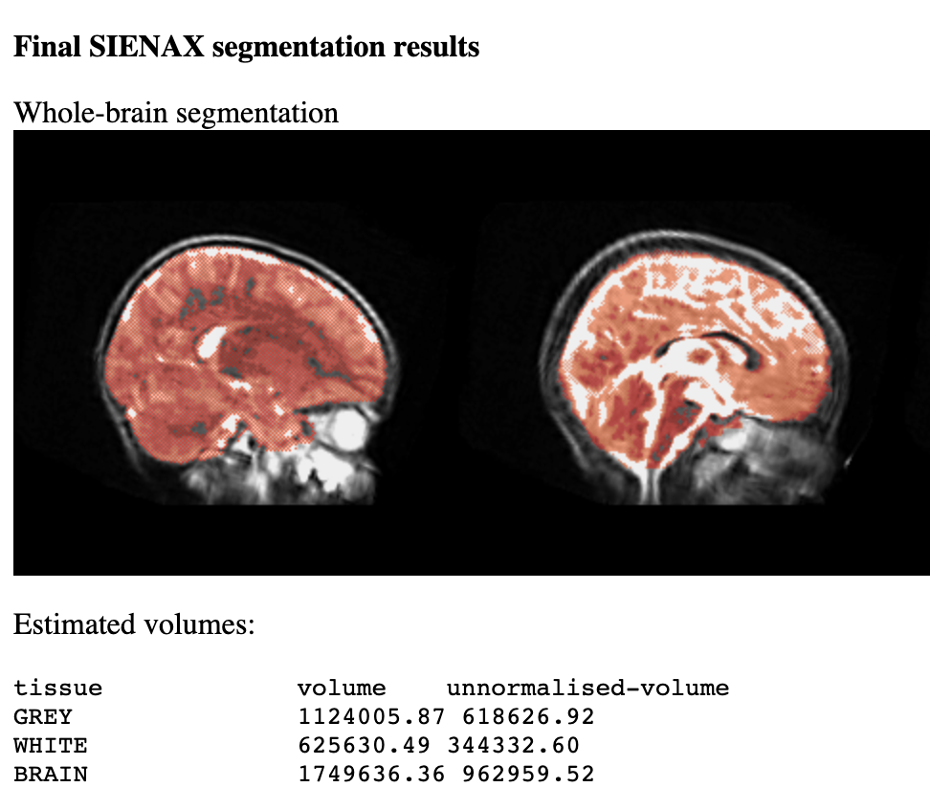
Flywheel workflow
Select analysis tab
Sagittal T2-Weighted
2
Chose type of analysis
3
Select ‘gear’ from list
1
6
Check analysis logs
5
Specify Input
4
7
8
View results
Work in progress:
Automatically set image reconstruction to run when matching input data found
Set SynthSeg, SIENX, etc. to run when reconstruction images found

Slide 5
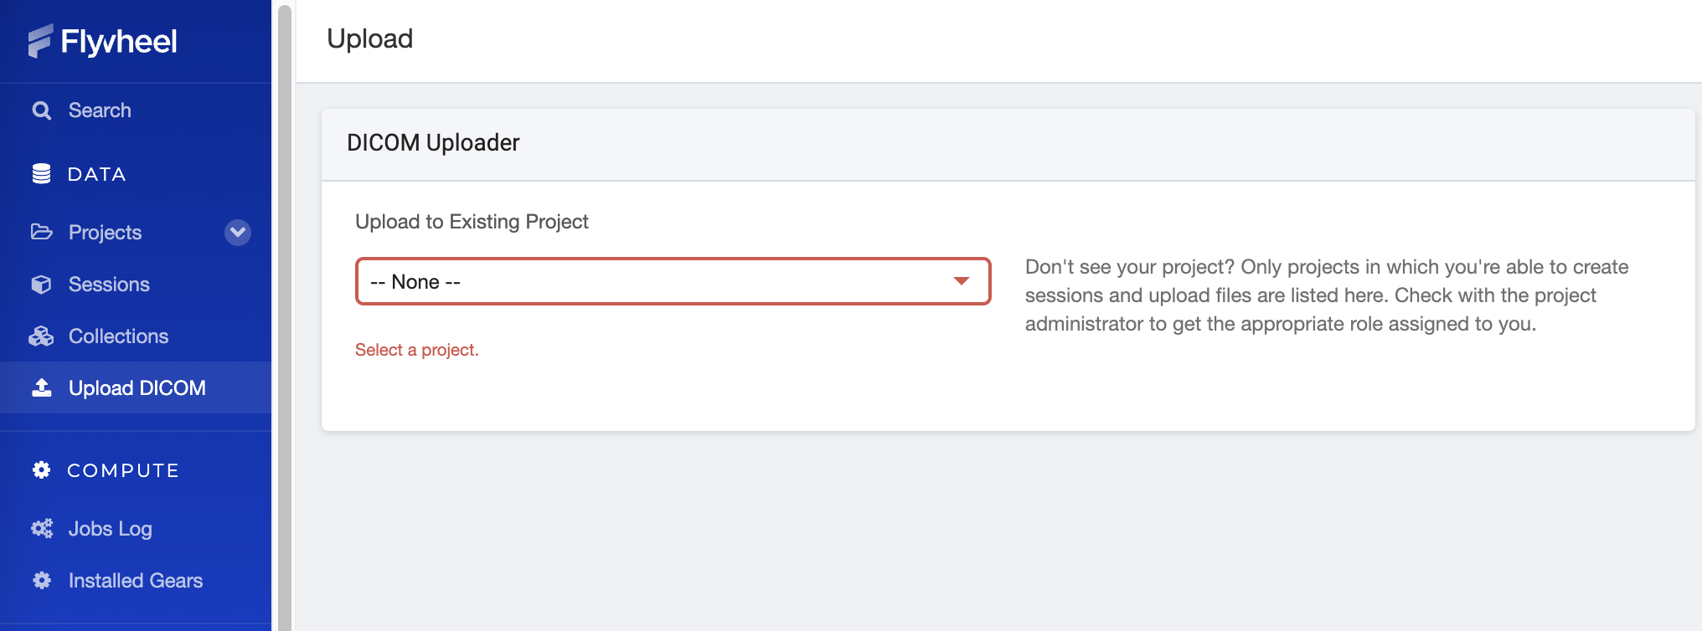
Main ways to upload data
Web interface
Command line interface (CLI)
fw injest dicom
fw injest template
Default desired option
Expects specific dicom headers
Flywheel structure:
ID = patientID
Session = timestamp
Acquisition labels can be BIDSified by including a lookup table (csv) and running curation gear
When dicom headers not ideal can read folder names
Project > ID > Session > Acquisition
(Khula > Khula001 > 3months > T1w > xxxx.dcm
Requires template.yaml
- Unless very few small files, avoid

Slide 6
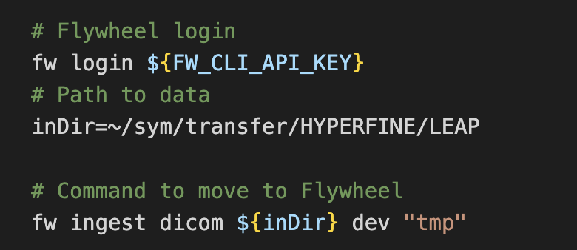
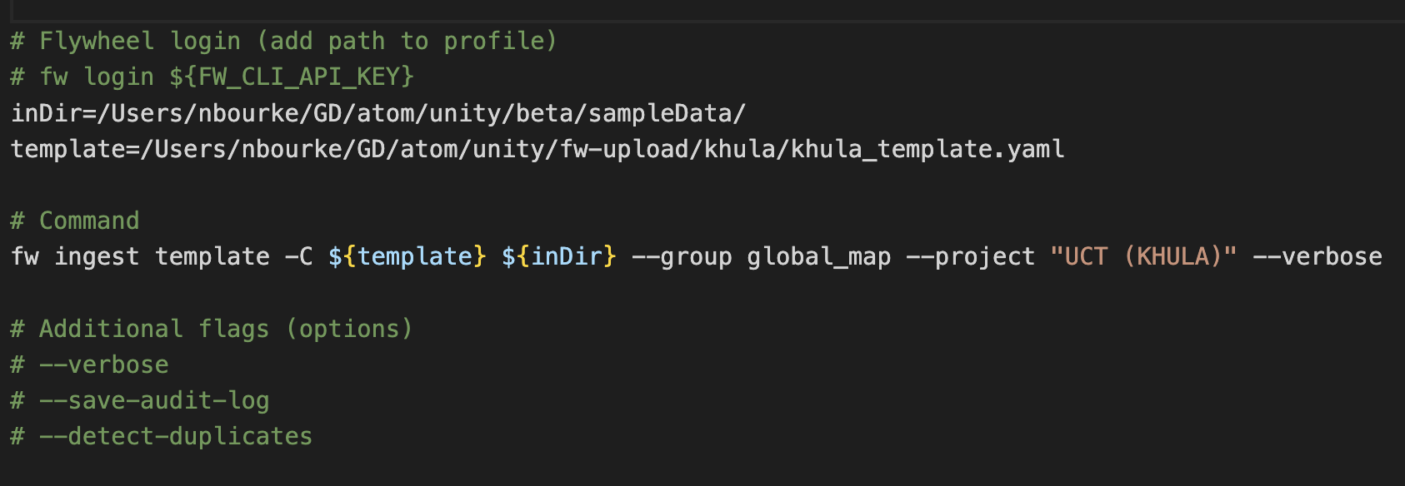
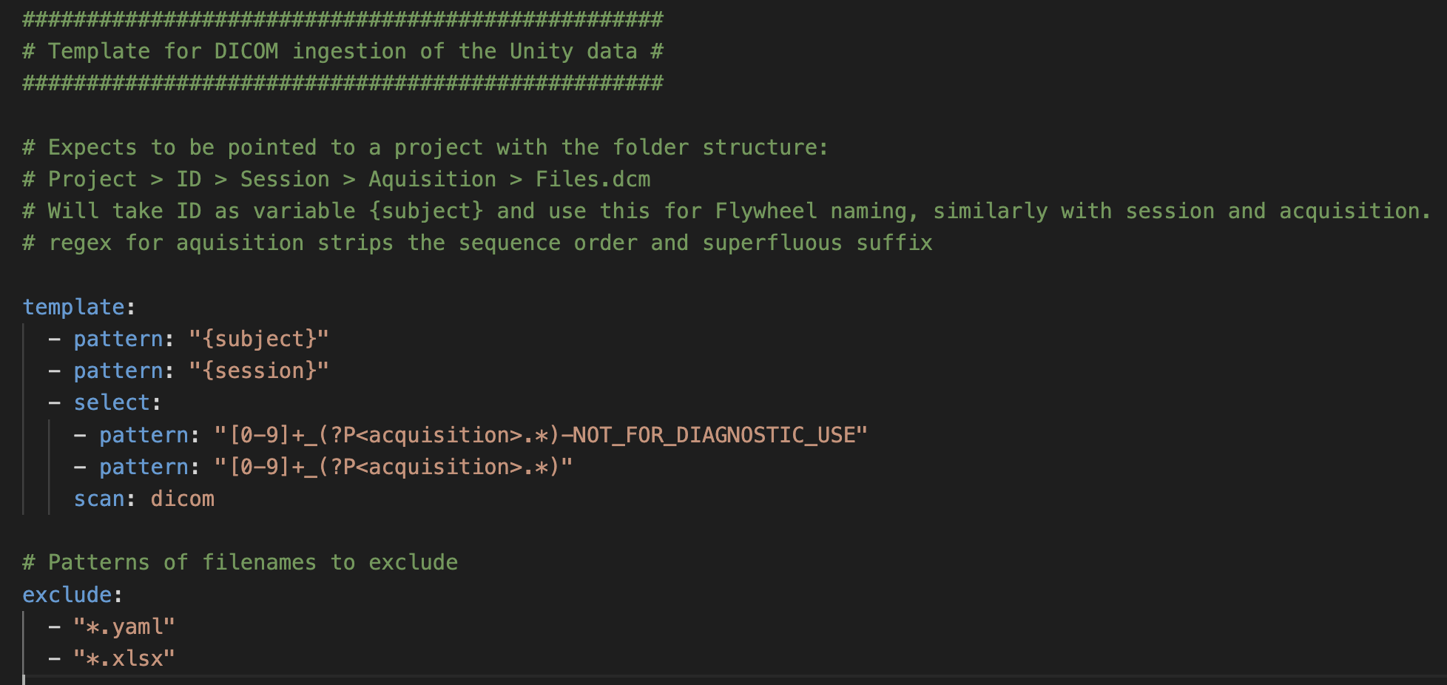
Injest data (CLI commands)
Injest dicom
Injest template
All BMGF projects are under group ‘global_map’
Will be asked to confirm upload when the project structure has been calculated: Check this looks correct before proceeding
Expected number of subjects, sessions, acquisitions

